Slide 1
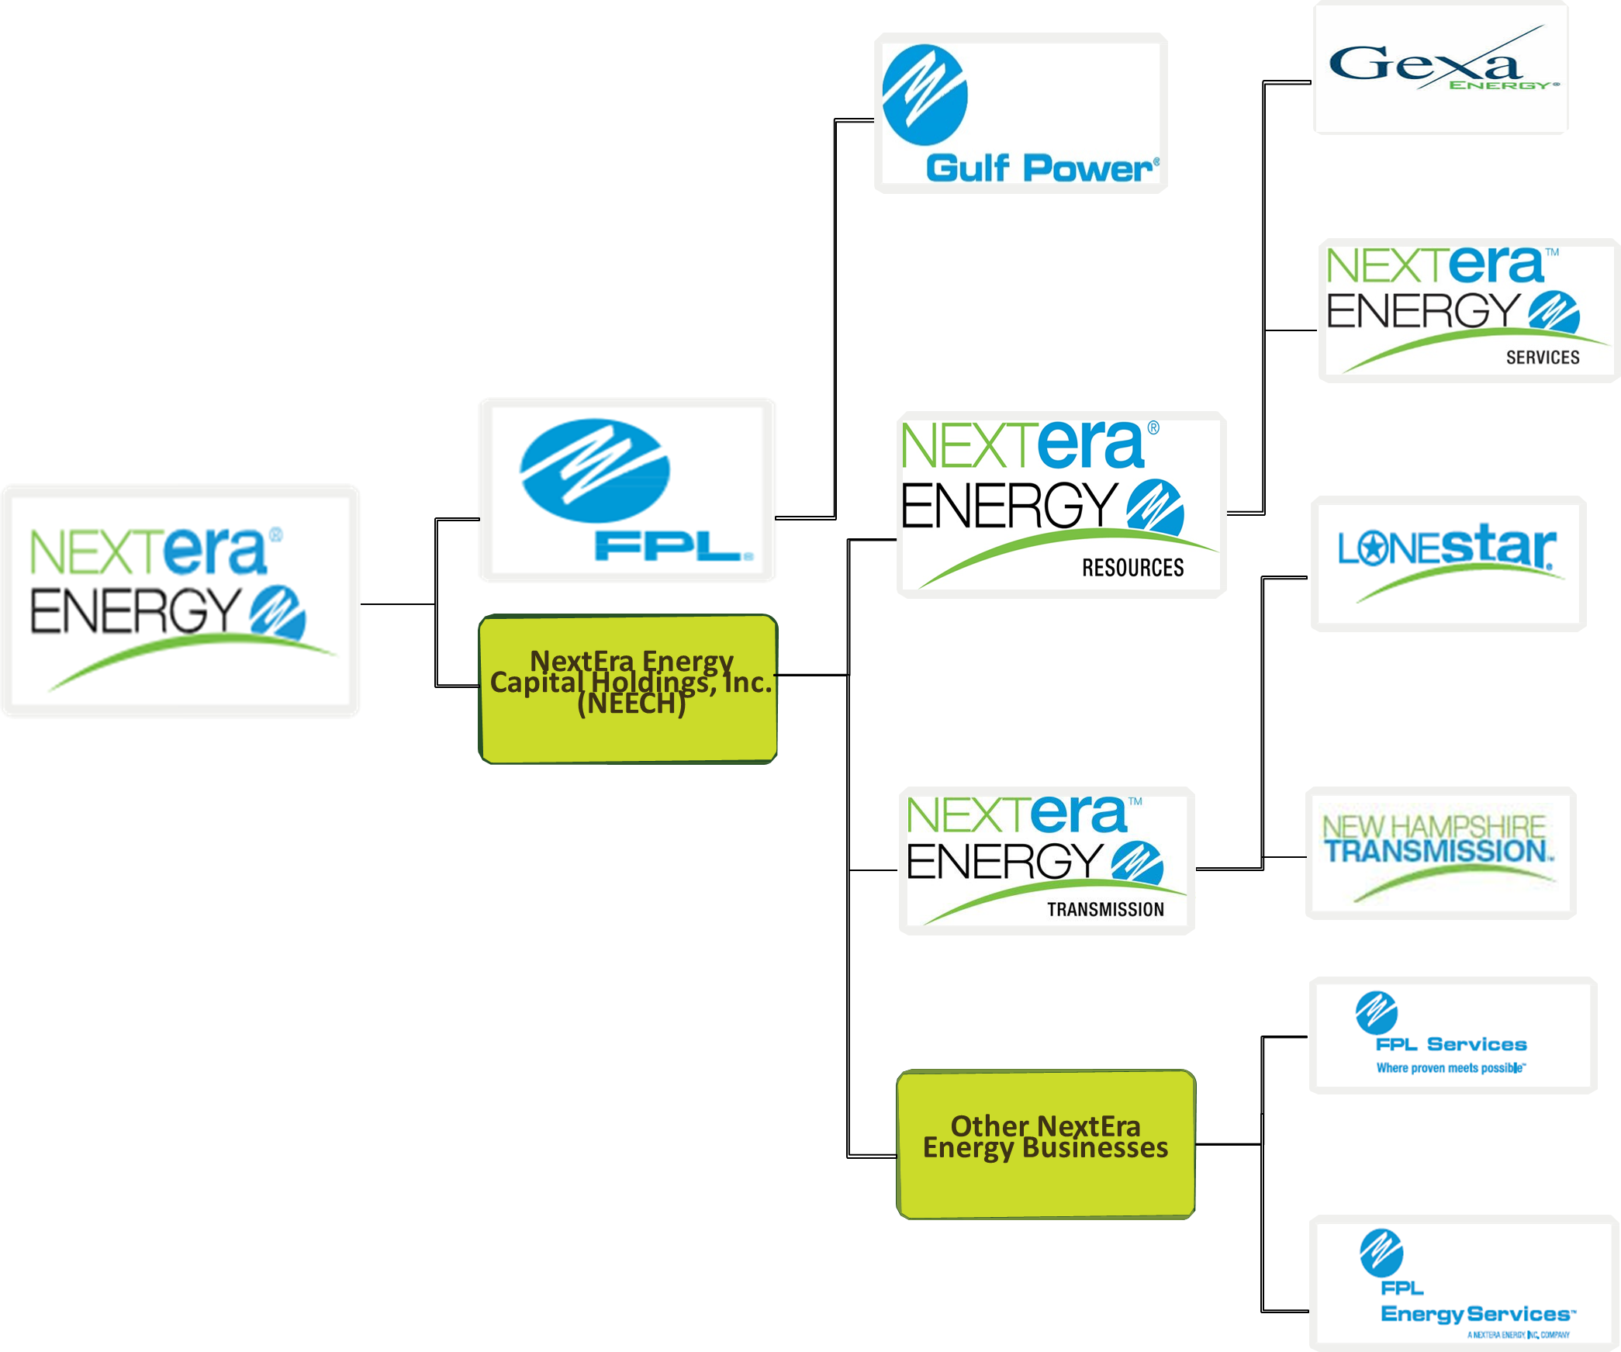
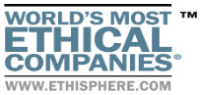






$16.7 B
Revenue in FY 2018
One of the World's Most Ethical Companies by Ethisphere Institute
Largest Electric Utility in Florida
NextEra Energy Subsidiaries
4.9 million
Customers
Largest Utility in US by Market Cap
#1 on Fortune’s list of World’s Most Admired Company in Electric & Gas Utilities Industry
$83 B
14,500
Employees
47 GW
Generation Capacity
Operations in 32 states in
US & 4 provinces in Canada
36
One of America's Best Employers
#167
Fortune 500 List
NextEra Energy Vision: Be North America’s Leader in the Generation and Delivery of Clean Energy

